Slide 1

Status of the APEnet+ project
davide.rossetti@roma1.infn.it
Lattice 2011
Squaw Valley, Jul 10-16, 2011

Slide 2
Index
GPU accelerated cluster and the APEnet+ interconnect
Requirements from LQCD application(s)
The platform constraints: PCIe, links
Accelerating the accelerator ☺
Programming model
The RDMA API
CUOS
Future devel

Slide 3
The APEnet+ History
Custom HPC platform: APE (86), APE100 (94), APEmille (99), apeNEXT (04)
Cluster Interconnect:
  2003-2004: APEnet V3
  2005: APEnet V3+, same HW with RDMA API
  2006-2009: DNP, or APEnet goes embedded
  2011: APEnet V4 aka APEnet+

Slide 4
Why a GPU cluster today
GPU cluster has:
Very good flops/$ W/$ ratios
Readily available
Developer friendly, same technology from laptop to cluster
Good support from industry
Active developments for LQCD
Missing piece: a good network interconnect

Slide 5
APEnet+ HW
Logic structure
Test card
Final card
CAVEAT: immature situation, rapidly converging
Very early figures, improving every day
Releasing conservative assumptions
Eg: in a few hours, from 30us to 7us latency

Slide 6
APEnet+ HW
X⁺
X⁻
Y⁺
Y⁻
Z⁺
Z⁻
  3D Torus, scaling up to thousands of nodes
    packet auto-routing
    6 x 34+34 Gbps links
    Fixed costs: 1 card + 3 cables
  PCIe X8 gen2
    peak BW 4+4 GB/s
  A Network Processor
    Powerful zero-copy RDMA host interface
    On-board processing
    Experimental direct GPU interface
  SW: MPI (high-level), RDMA API (low-level)
torus
link
torus
link
torus
link
torus
link
torus
link
torus
link
Altera Stratix IV
router
7x7 ports switch
routing logic
arbiter
TX/RX FIFOs & Logic
collective communication block
100/1000 Eth port
128@250MHz bus
PCIe X8 Gen2 core
NIOS II processor
memory controller
DDR3
Module
PCIe X8 Gen2 8@5 Gbps
FPGA blocks

Slide 7
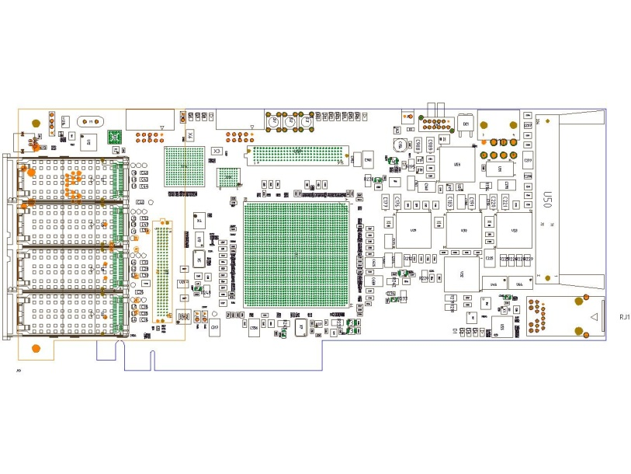
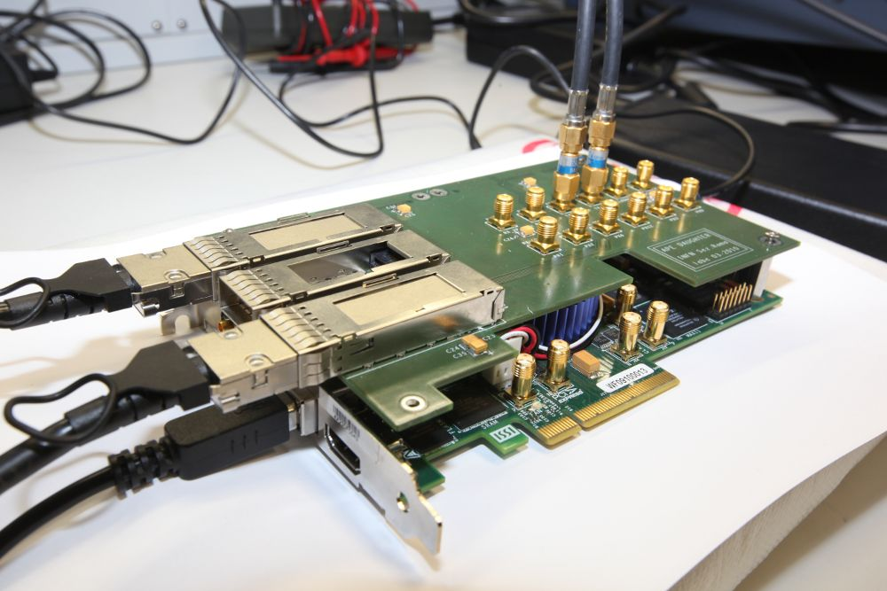
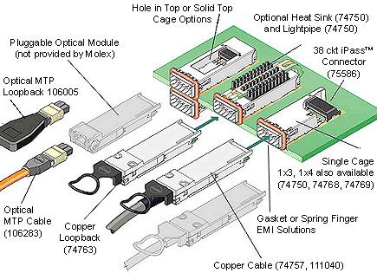
APEnet+ HW
Test Board
Based on Altera development kit
Smaller FPGA
Custom daughter card with 3 link cages
Max link speed is half
APEnet+ final board, 4+2 links
Cable options: copper or fibre

Slide 8
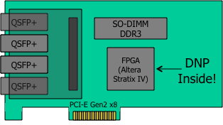
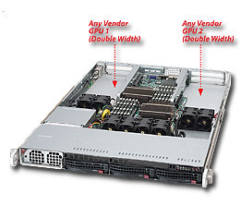
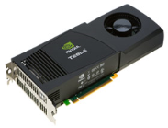
Requirements from LQCD
Our GPU cluster node:
A dual-socket multi-core CPU
2 Nvidia M20XX GPUs
one APEnet+ card
Our case study:
64^3x128 lattice
Wilson fermions
SP

Slide 9
Requirements from LQCD
even/odd + γ projection trick Dslash:
  f(L, N_{GPU}) = 1320/2 × N_{GPU} × L³T flops
  r(L, N_{GPU}) = 24/2 × 4 × (6/2 N_{GPU} L²T + x/2 L³) bytes
  with x=2,2,0 for N_{GPU}=1,2,4
Balance condition*, perfect comp-comm overlap
  f(L, N_{GPU})/perf(N_{GPU}) = r(L, N_{GPU})/BW ➔
  BW(L, N_{GPU}) = perf(N_{GPU}) × r(L, N_{GPU}) / f(L, N_{GPU})
* Taken from Babich (STRONGnet 2010), from Gottlieb via Homgren

Slide 10
Requirements from LQCD (2)
For L=T, N_{GPU}=2, perf 1 GPU=150 Gflops sustained:
  BW(L, 2) = 2×150×10⁹ × 24 (6×2+2)L³ / (1320× L⁴) = 76.3/L GB/s
  14 messages of size m(L) = 24 L³ bytes
2 GPUs per node, at L=32:
  E/O prec. Dslash compute-time is 4.6ms
  BW(L=32) is 2.3 GB/s
  Transmit 14 buffers of 780KB, 320us for each one
  Or 4 KB pkt in 1.7us

Slide 11
Requirements from LQCD (2)
GPU lattice | GPUs per node | Node lattice | Global lattice | # of nodes | # of GPUs | Req BW GB/2
16ˆ3*16 | 2 | 16ˆ3*32 | 64ˆ3*128 | 256 | 512 | 4.3
16ˆ3*32 | 2 | 16ˆ3*64 | 64ˆ3*128 | 128 | 256 | 4.0
32ˆ3*32 | 2 | 32ˆ3*64 | 64ˆ3*128 | 16 | 32 | 2.1
16ˆ3*32 | 4 | 16ˆ3*128 | 64^3*128 | 64 | 256 | 7.4
32ˆ3*32 | 4 | 32ˆ3*128 | 64^3*128 | 8 | 32 | 3.7
Single 4KB pkt lat is: 1.7us
At PCIe x8 Gen 2 (~ 4 GB/s) speed: 1us
At Link (raw 34Gbps or ~ 3 GB/s) speed: 1.36us
APEnet+ SW + HW pipeline: has ~ 400 ns !?!
Very tight time budget!!!

Slide 12
The platform constraints
PCIe *:
  One 32bit reg posted write: 130ns
  One regs read: 600ns
  8 regs write: 1.7us
PCIe is a complex beast!
  Far away from processor and memory (on-chip mem ctrl)
  Mem reached through another network (HT or QPI)
  Multiple devices (bridges, bufs, mem ctrl) in between
  Round-trip req (req + reply) ~ 500ns !!!
* Measured with a tight loop and x86 TSC

Slide 13
A model of pkt flow
t_{ovr}
t_{pci}
t_{pci}
t_{link}
Pkt 1
t_{sw}
t_{link}
t_{pci}
t_{wire}
Pkt 1
t_{pci} > t_{link}
torus
link
torus
link
torus
link
torus
link
torus
link
torus
link
router
t_{sw} +t_{wire} + t_{sw} = 260ns
Altera Stratix IV
TX/RX FIFOs & Logic
128@250MHz bus
collective communication block
PCIe X8 Gen2 core
NIOS II processor
memory controller
t_{ovr} + 2t_{sw} + t_{link} + t_{wire}
t_{link}

Slide 14
Hard times
Two different traffic patterns:
Exchanging big messages is good
  Multiple consecutive pkts
  Hidden latencies
  Every pkt latency (but the 1st ) dominated by t_{link}
A classical latency test (ping-pong, single pkt, down to 1 byte payload) is really hard
  Can’t neglect setup and teardown effects
  Hit by full latency every time
  Need very clever host-card HW interface

Slide 15
GPU support
Some HW features developed for GPU
P2P
Direct GPU

Slide 16
The traditional flow
Network
CPU
GPU
Director
kernel
transfer
calc
CPU memory
GPU memory

Slide 17
GPU support: P2P
CUDA 4.0 brings:
  Uniform address space
  P2P among up to 8 GPUs
Joint development with NVidia
  APElink+ acts as a peer
  Can read/write GPU memory
Problems:
  work around current chipset bugs
  exotic PCIe topologies
  PCIe topology on Sandy Bridge Xeon

Slide 18
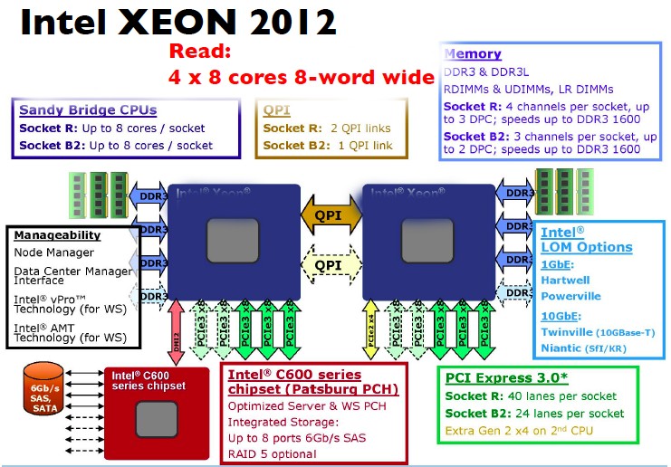
P2P on Sandy Bridge

Slide 19
GPU: Direct GPU access
Specialized APEnet+ HW block
GPU initiated TX
Latency saver for small size messages
SW use: see cuOS slide

Slide 20
Improved network
APEnet+
CPU
GPU
Director
kernel
transfer
Direct GPU access
P2P transfer
CPU memory
GPU memory

Slide 21
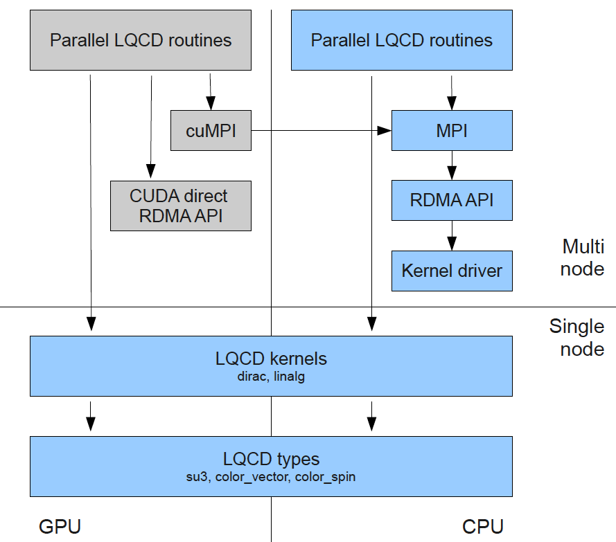
SW stack
GPU centric
programming
model

Slide 22
SW: RDMA API
RDMA Buffer management:
  am_register_buf, am_unregister_buf
  expose memory buffers
  2 types: SBUF use-once, PBUF are targets of RDMA_PUT
  Typically at app init time
Comm primitives:
  Non blocking, async progress
  am_send() to SBUF
  am_put() to remote PBUF via buffer id
  am_get() from remote PBUF (future work)
Event delivery:
  am_wait_event()
  When comm primitives complete
  When RDMA buffers are accessed

Slide 23
SW: RDMA API
Typical LQCD-like CPU app
Same app with GPU
Init:
  Allocate buffers for ghost cells
  Register buffers
  Exchange buffers ids
Computation loop:
  Calc boundary
  am_put boundary to neighbors buffers
  Calc bulk
  Wait for put done and local ghost cells written
Init:
  cudaMalloc() buffers on GPU
  Register GPU buffers
  Exchange GPU buffer ids
Computation loop:
  Launch calc_bound kernel on stream0
  Launch calc_bulk kernel on stream1
  cudaStreamSync(stream0)
  am_put(rem_gpu_addr)
  Wait for put done and buffer written
  cudaStreamSync(stream1)
Thanks to P2P!

Slide 24
SW: MPI
OpenMPI 1.5
Apelink BTL-level module
2 protocols based on threshold
  Eager: small message size, uses plain send, async
  Rendezvous: pre-register dest buffer, use RDMA_PUT, need synch
Working on integration of P2P support
  Uses CUDA 4.0 UVA

Slide 25
SW: cuOS
cuOS = CUDA Off-loaded System services
cuMPI: MPI APIs …
cuSTDIO: file read/write ...
... in CUDA kernels!
Encouraging a different programming model:
  program large GPU kernels
  with few CPU code
  hidden use of direct GPU interface
  need resident blocks (global sync)
cuOS is developed by APE group and is open source
http://code.google.com/p/cuos

Slide 26
SW: cuOS in stencil computation
traditional CUDA:
//GPU
__global__ void compute_borders(){}
__global__ void compute_bulk(){}
__global__ void reduce(){}
//CPU
main() {
do {
compute_bulk<<<,1>>>();
compute_borders<<<,0>>>();
cudaMemcpyAsync(boundary, 0);
cudaStreamSynchronize(0);
MPI_Sendrecv(boundary, frames);
cudaMemcpyAsync(frames, 0);
cudaStreamSynchronize(0);
cudaStreamSynchronize(1);
local_residue<<<,1>>>();
cudaMemcpyAsync(lres, 1);
cudaStreamSynchronize(1);
MPI_Reduce(gres, lres);
} while(gres > eps);
}
using in-kernel MPI (cuOS):
//GPU
__global__ void solver() {
do {
compute_borders();
cuMPI_Isendrecv(boundary, frames);
compute_bulk();
cuMPI_Wait();
local_residue(lres);
cuMPI_Reduce(gres, lres);
} while(gres > eps);
}
// CPU
main() {
...
solver<<<nblocks,nthreads>>>();
cuos->HandleSystemServices();
...
}

Slide 27
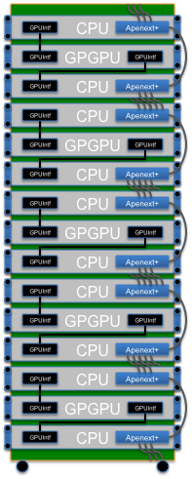
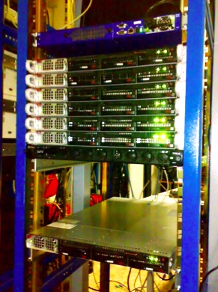
QUonG reference platform
Today:
  7 GPU nodes with Infiniband for applications development:
  2 C1060 + 3 M2050 + S2050
  2 nodes HW devel:
  C2050 + 3 links card APEnet+
Next steps, green and cost effective system within 2011
  Elementary unit:
      multi-core Xeon (packed in 2 1U rackable system)
      S2090 FERMI GPU system (4 TFlops)
      2 APEnet+ board
  42U rack system:
        60 TFlops/rack peak
        25 kW/rack (i.e. 0.4 kW/TFlops)
        300 k€/rack (i.e. 5 K€/Tflops)

Slide 28
Status as of Jun 2011
Early prototypes of APEnet+ card
  Due in a few days
  After some small soldering problems
Logic: fully functional stable version
  Can register up to 512 4KB buffers
  Developed on test platform
  OpenMPI ready
Logic: early prototype of devel version
  FPGA processor (32bit 200MHz 2GB RAM)
  Unlimited number and size of buffers (MMU)
  Enabling new developments

Slide 29
Future works
Goodies from next gen FPGA
  PCIe Gen 3
  Better/faster links
  On-chip processor (ARM)
Next gen GPUs
  NVidia Kepler
  ATI Fusion ?
  Intel MIC ?

Slide 30
Game over…
Let’s collaborate… we need you!!!
Proposal to people interested in GPU for LQCD
Why don’t me meet together, ½ hour, here in Squaw Valley ?????

Slide 31
Back up slides

Slide 32
Accessing card registers through PCIe
spin_lock/unlock: total dt=1300us loops=10000 dt=130ns
spin_lock/unlock_irq: total dt=1483us loops=10000 dt=148ns
spin_lock/unlock_irqsave: total dt=1727us loops=10000 dt=172ns
BAR0 posted register write: total dt=1376us loops=10000 dt=137ns
BAR0 register read: total dt=6812us loops=10000 dt=681ns
BAR0 flushed register write: total dt=8233us loops=10000 dt=823ns
BAR0 flushed burst 8 reg write: total dt=17870us loops=10000 dt=1787ns
BAR0 locked irqsave flushed reg write: total dt=10021us loops=10000 dt=1002ns

Slide 33
LQCD requirements (3)
Report 2 and 4 GPUS per node
L=16,24,32

Slide 38
Latency on HW simulator

Slide 39
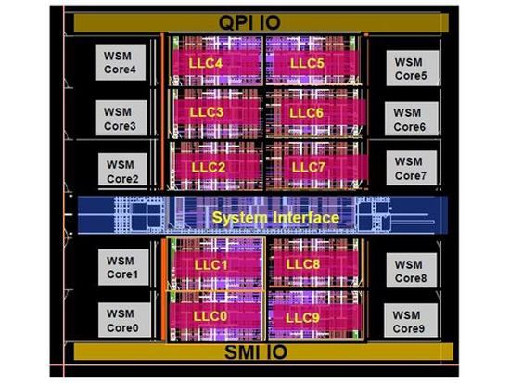
Intel Westmere-EX
Lot’s of caches!!!
Few processing:
4 FP units are probably 1 pixel wide !!!

Slide 40
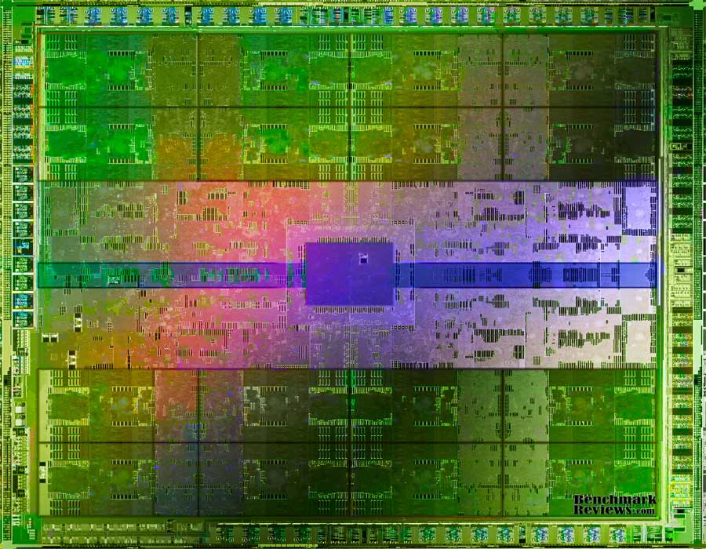
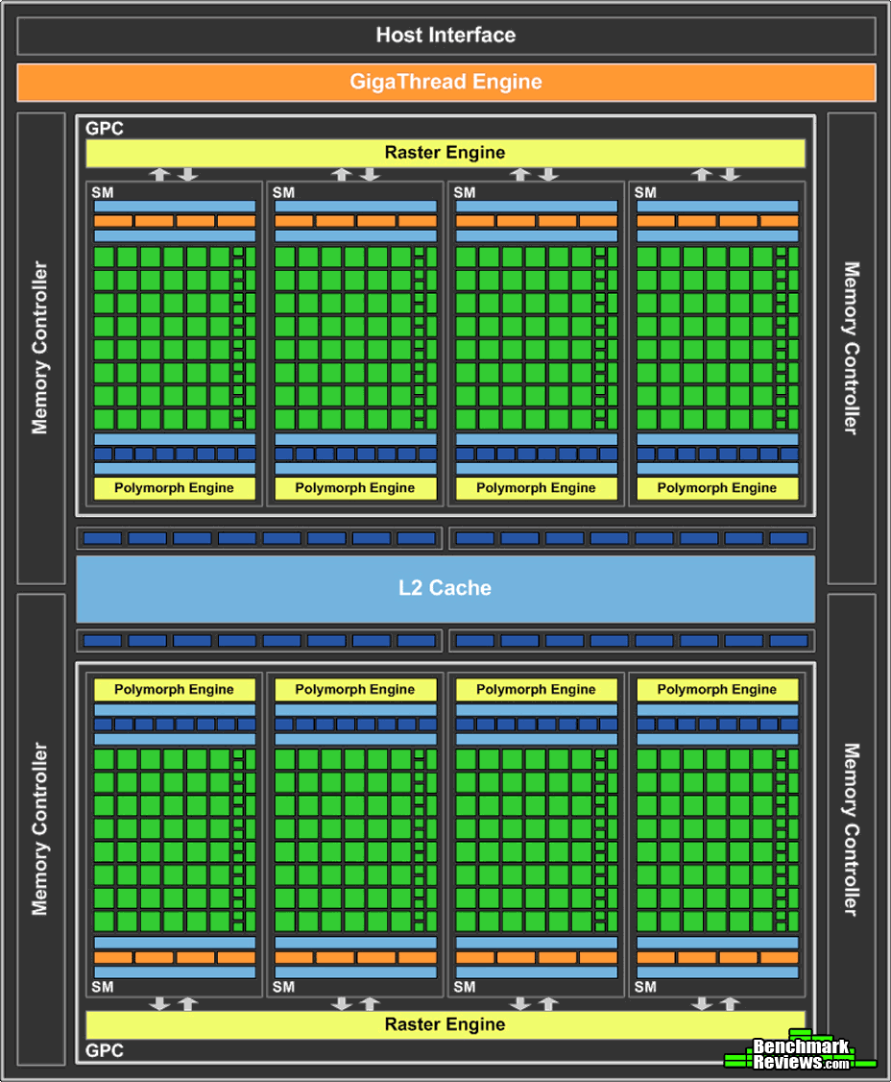
NVidia GPGPU
Lot’s of computing units !!!

Slide 41
So what ?
What are the differences ?
Why should we bother ?
They show different trade-offs !!
And the theory is…..

Slide 42
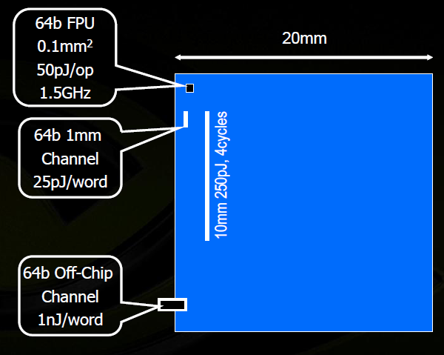
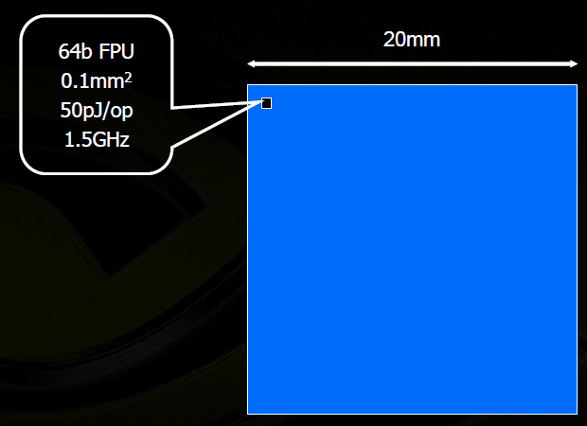
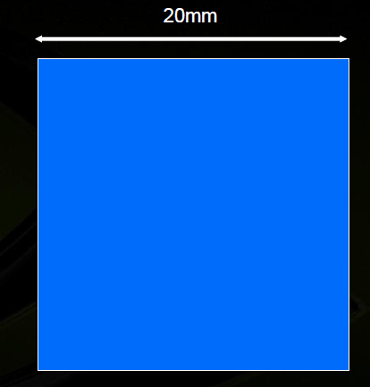
Where the power is spent
“chips are power limited and most power is spent moving data around”*
4 cm² chip
4000 64bit FPU fit
Moving 64bits on chip == 10FMAs
Moving 64bits off chip == 20FMAs
*Bill Dally, Nvidia Corp. talk at SC09

Slide 43
So what ?
What are the differences?
Why should we bother?
Today: at least a factor 2 in perf/price ratio
Tomorrow: CPU & GPU converging, see current ATI Fusion

Slide 44
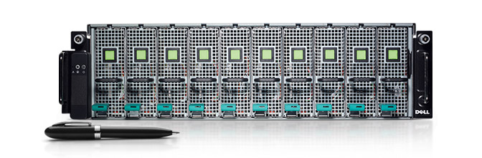
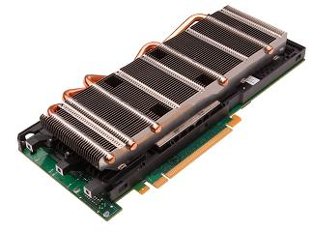
With latest top GPUs…
Dell PowerEdge C410x

Slide 45
Executive summary
GPUs are prototype of future many-core arch (MIC,…)
Good $/Gflops and $/W
Increasingly good for HEP theory groups (LQCD,…)
Protect legacy:
  Run old codes on CPU
  Slowly migrate to GPU

Slide 46
A first exercise
Today needs: lots of MC
Our proposal: GPU accelerated MC
Unofficially: interest by Nvidia …
CERN
NVidia
Intel MIC
Closing the loop ☺

Slide 47
Final question
A GPU and Network accelerated cluster:
Could it be the prototype of the SuperB computing platform ?

